Slide 1
Budgeting Basics
Presenter: Diane H. Leonard, GPC, STSI

Slide 2
About Diane H. Leonard, GPC, STSI
Grant Professional Certified (GPC)
Approved Trainer, Grant Professionals Association
Scrum Trainer by Scrum Inc. ™ (STSI)
Certified Virtual Presenter (eSpeakers)
Began career as a grantmaker
Over $82 million awarded for clients
Owner, DH Leonard Consulting & Grant Writing Services, LLC
Runner and coffee drinker

Slide 3
What We Will Cover:
Understanding Budget Guidelines
Direct vs Indirect Expenses
Matching and Cost-Share
Budget Justification/Budget Narrative
Financial Stability & Sustainability

Slide 4
Proactive Grant Seeking
I. Understanding Budget Guidelines from Grantmakers
Which comes first…
YOUR project budget?
OR
THE grant application budget?

Slide 5
Proactive Grant Seeking
I. Understanding Budget Guidelines from Grantmakers
The Answer is…
YOUR project budget

Slide 6
Proactive Grant Seeking
I. Understanding Budget Guidelines from Grantmakers

Slide 7
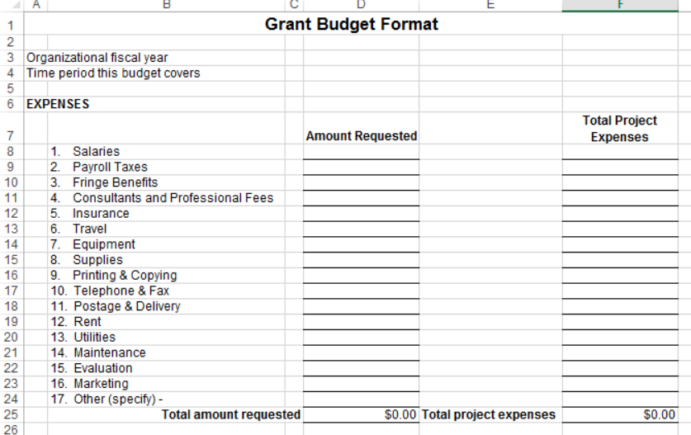
Proactive Grant Seeking
I. Understanding Budget Guidelines from Grantmakers

Slide 8
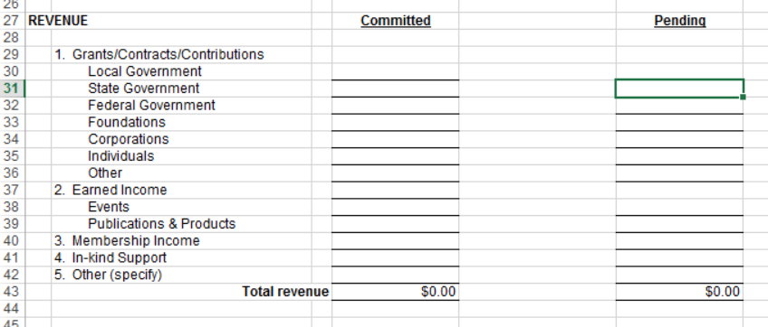
Proactive Grant Seeking
I. Understanding Budget Guidelines from Grantmakers

Slide 9
I. Understanding Budget Guidelines from Grantmakers
What does the grantmaker allow? Want to know?
Expense Information Including:
Personnel
Non-Personnel
Indirect Cost Rate
Income Information Including:
Program Income
Grants (Pending & Committed)
Donations, Gifts & Special Events

Slide 10
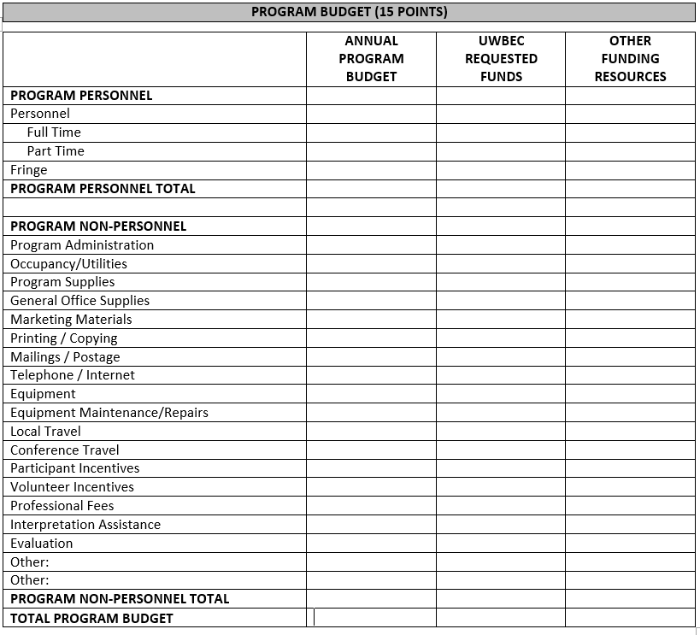
I. Understanding Budget Guidelines from Grantmakers
Real Example:
Scoring criteria clear
Breakout of personnel versus non-personnel

Slide 11
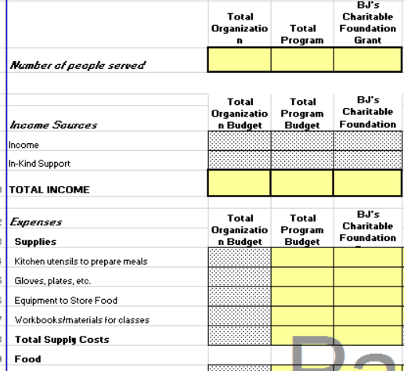
I. Understanding Budget Guidelines from Grantmakers
Real Example:
Unique format
Specific line items align with grantmaker priority

Slide 12
Questions
Think of a question afterward?
Email Diane at diane@dhleonardconsulting.com
Q&A

Slide 13
Budgeting Basics
Presenter: Diane H. Leonard, GPC, STSI

Slide 14
What We Will Cover:
Understanding Budget Guidelines
Direct vs Indirect Expenses
Matching and Cost-Share
Budget Justification/Budget Narrative
Financial Stability & Sustainability

Slide 15
II. Direct vs Indirect Expenses
§ 200.413 Direct Costs
Easily identifiable specifically with a particular final cost objective meaning a federal grant, program or project.
Examples: Staff salaries, materials and supplies, equipment, contractual, travel etc.

Slide 16
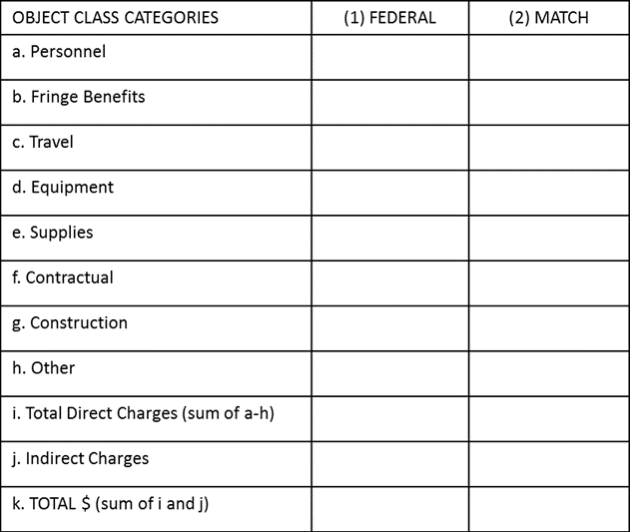
II. Direct vs Indirect Expenses
The federal SF-424 budget forms are deceivingly simple.
You often have to complete additional budget forms in agency specific forms OR at least provide a detailed budget justification showing all of the detail for your expenses.

Slide 17
II. Direct vs Indirect Expenses
§ 200.56 Indirect Costs
Costs incurred for a common or joint purpose benefitting more than one cost objective and are not readily assignable are “allocated”
Examples: CEO & CFO salaries, Procurement Office, Information Technology, Payroll & Human Resources Office etc.

Slide 18
II. Direct vs Indirect Expenses
Once an organization has a federally approved indirect cost rate, that becomes your go-to percentage used for calculating the indirect expenses in all application budgets.
BUT, be careful!
Organizations must apply that indirect cost rate to the correct distribution base
For example, is modified total direct costs (MTDC) to be used, or something else, like salaries?

Slide 19
II. Direct vs Indirect Expenses
§ 200.414 De Minimis Rate
Any non-Federal entity that does not have a current negotiated indirect cost rate (including provisional rate) may elect to charge a de minimis rate of 10% Modified Total Direct Costs (MTDC) which may be used indefinitely.
10%

Slide 20
II. Direct vs Indirect Expenses
The Modified Total Direct Cost (MTDC) indirect cost rate may be applied to:
All direct salaries and wages charged to the award
Applicable fringe benefits
Materials and supplies
Services
Travel
The first $25,000 of each sub-awards or sub-contracts

Slide 21
II. Direct vs Indirect Expenses
When do I apply for an indirect cost rate?
You *may* apply for an indirect cost rate if your organization received a federal grant that allows a negotiated rate.
Which agency is my cognizant agency?
Your cognizant agency will most likely be the agency from whom you receive the most federal funding

Slide 22
Questions
Think of a question afterward?
Email Diane at diane@dhleonardconsulting.com
Q&A

Slide 23
Budgeting Basics
Presenter: Diane H. Leonard, GPC, STSI

Slide 24
What We Will Cover:
Understanding Budget Guidelines
Direct vs Indirect Expenses
Matching and Cost-Share
Budget Justification/Budget Narrative
Financial Stability & Sustainability

Slide 25
III. Matching and Cost-Share
Matching and cost share sources:
If the matching funds are not “cash” the match must be NOT from federal sources.
“Cash” is a great fit as applicant, state, local, or other sources.

Slide 26
III. Matching and Cost-Share
Applications with basic cost sharing or matching requirement have simple instructions with occasional supporting information.

Slide 27
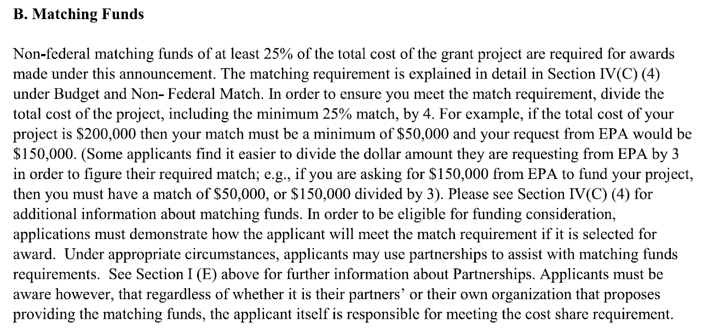
III. Matching and Cost-Share
The level of description is an immediate clue that this is a UNIQUE calculation for matching funds.

Slide 28
III. Matching and Cost-Share
Common questions if you have MORE match than required:
“What if no matching is required, but we have matching funds committed to the project?”
“Are we more competitive if we show matching beyond what is required?”
See § 200.306 - Cost sharing or matching:
“Voluntary committed cost sharing is not expected. It cannot be used as a factor during the merit review of applications or proposals”

Slide 29
Questions
Think of a question afterward?
Email Diane at diane@dhleonardconsulting.com
Q&A

Slide 30
Budgeting Basics
Presenter: Diane H. Leonard, GPC, STSI

Slide 31
What We Will Cover:
Understanding Budget Guidelines
Direct vs Indirect Expenses
Matching and Cost-Share
Budget Justification/Budget Narrative
Financial Stability & Sustainability

Slide 32
IV. Budget Justification/Budget Narrative
VS

Slide 33
IV. Budget Justification/Budget Narrative
Use of formulas within budget forms and within budget narratives
Critical to have budget narrative/budget justifications align with the project narrative

Slide 34
IV. Budget Justification/Budget Narrative
Common Inconsistencies:
Budget Salaries vs Staffing Plan
Budget Salaries vs Work Plan/Logic Model
Budget Mileage vs Work Plan
Budget Equipment/Supplies vs Work Plan

Slide 35
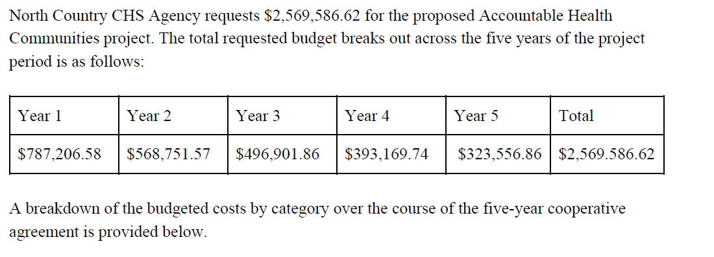
IV. Budget Justification/Budget Narrative
Real Example:

Slide 36
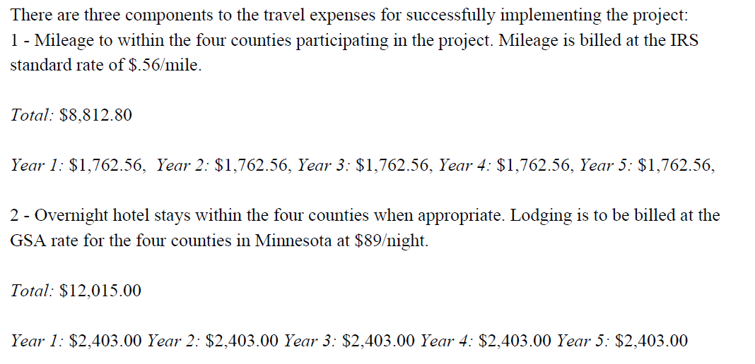
IV. Budget Justification/Budget Narrative
Real Example:

Slide 37
Proactive Grant Seeking
IV. Budget Justification/Budget Narrative

Slide 38
Proactive Grant Seeking
IV. Budget Justification/Budget Narrative
Provide details
Provide formulas
Provide narrative explanations

Slide 39
Proactive Grant Seeking
IV. Budget Justification/Budget Narrative
Review yourself reading budget first, THEN narrative
Have colleagues review budget and proposal for consistency & accuracy

Slide 40
Questions
Think of a question afterward?
Email Diane at diane@dhleonardconsulting.com
Q&A

Slide 41
Budgeting Basics
Presenter: Diane H. Leonard, GPC, STSI

Slide 42
What We Will Cover:
Understanding Budget Guidelines
Direct vs Indirect Expenses
Matching and Cost-Share
Budget Justification/Budget Narrative
Financial Stability & Sustainability

Slide 43
V. Financial Stability & Sustainability
Real Example:

Slide 44
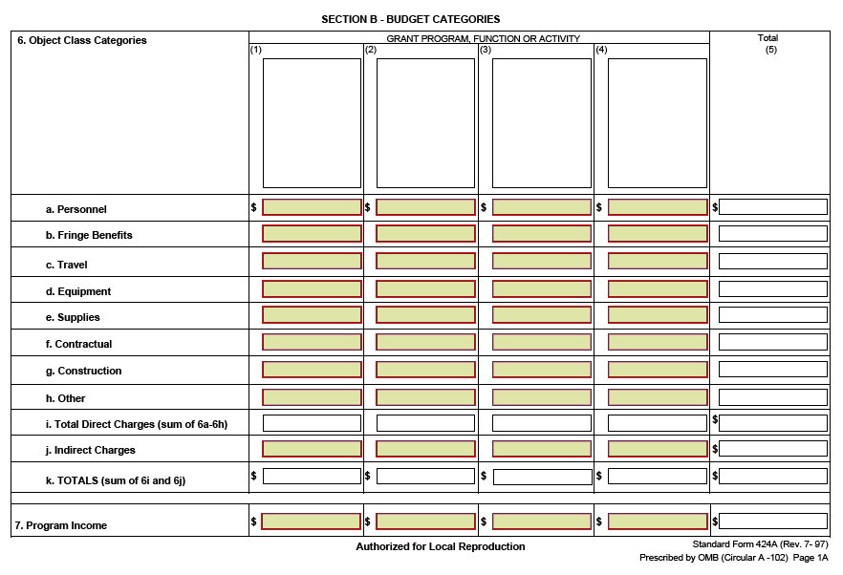
Proactive Grant Seeking
V. Financial Stability & Sustainability

Slide 45
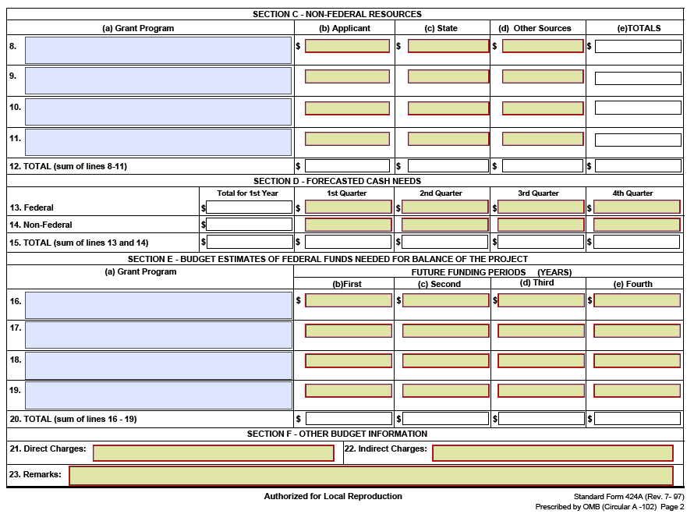
Proactive Grant Seeking
V. Financial Stability & Sustainability

Slide 46
Connect With Me!
Twitter: @dhlconsult
@dianehleonard
Facebook: DH Leonard Consulting
LinkedIn: Diane H. Leonard, GPC
Instagram: @dhleonardconsulting
YouTube: Don’t Let Grants Stress You Out
www.dhleonardconsulting.com

Slide 47
Questions
Think of a question afterward?
Email Diane at diane@dhleonardconsulting.com
Q&A

Slide 48
These modules are brought to you by
HRI, the NYSDOH and HRSA
The content of this publication is solely the responsibility of the authors and does not necessarily represent the official views of HRI or HRSA
Sponsor Reference Number (6H95RH001223002)

