Slide 1
Compelling Program Design Elements
Presenter: Diane H. Leonard, GPC, STSI

Slide 2
About Diane H. Leonard, GPC, STSI
Grant Professional Certified (GPC)
Approved Trainer, Grant Professionals Association
Scrum Trainer by Scrum Inc. ™ (STSI)
Certified Virtual Presenter (eSpeakers)
Began career as a grantmaker
Over $82 million awarded for clients
Owner, DH Leonard Consulting & Grant Writing Services, LLC
Runner and coffee drinker

Slide 3
What We Will Cover:
Logic Model Elements
SMART Objectives
Work Plan Elements

Slide 4
I. Logic Model Elements

Slide 5
I. Logic Model Elements
Theory of Change Model
A general representation of how you believe change will occur.

Slide 6
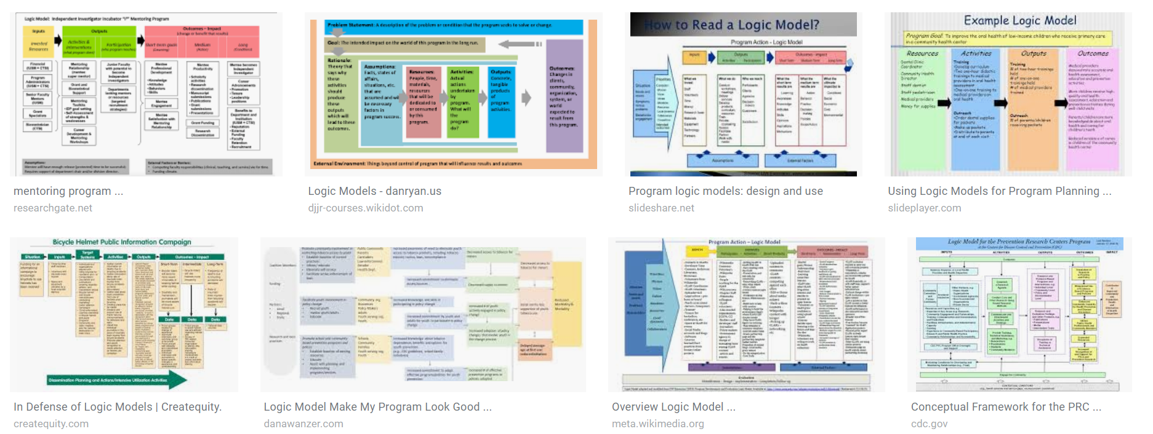
I. Logic Model Elements
2. Program Logic Model
An outline of resources, planned activities, outputs, and outcomes over time that reflect intended results.

Slide 7
I. Logic Model Elements
How do I know What Type I Am Reading?
Theory of Change? Or Program Logic Model?
Feature | Theory of Change | Program
Time Frame | No time | Time bound
Level of Detail | Low | High
Elements | Few (“do + get”) | Many
Primary Display | Graphics | Graphics + text
Focus | Generic | Targets + specified results

Slide 8
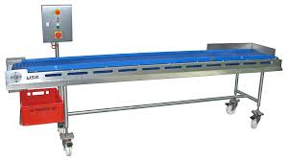
I. Logic Model Elements
Project Logic Model

Slide 9
I. Logic Model Elements
Project Logic Model Definitions
Input: A resource dedicated to or consumed by the program
Activity: Type of service the program provides to fulfil its mission. What the program does with the inputs.
Output: The direct product of program operation.
Outcome: Benefit to participants during or after participating in the program.
Indicator: Identifies what is being measured to track the program’s success.

Slide 10
I. Logic Model Elements
Step 1: Resources
Sometimes called inputs
Used to accomplish the stated activities
Include things like human, financial, organization, community, or systems resources

Slide 11
I. Logic Model Elements
Step 2: Activities
Specific actions that make up the program
Interventions deployed to secure the desired result/change
Reflect tools, processes, and events

Slide 12
I. Logic Model Elements
Step 3: Outputs
What will be produced or created through the activities
Can include descriptions of types, levels, and audiences or targets delivered by the program
Typically quantifiable

Slide 13
I. Logic Model Elements
Step 4: Short-term Outcomes
Outline anticipated changes
Often changes in awareness, knowledge, skill, and behavior
Usually measurable right after the activities have occurred
Dependent on the resources, activities, and outputs

Slide 14
I. Logic Model Elements
Step 5: Intermediate Outcomes
Outline anticipated changes
Often changes in awareness, knowledge, skill, and behavior
Usually measurable within a few months after an activity
Dependent on the resources, activities, and outputs

Slide 15
I. Logic Model Elements
Step 6: Long-term Outcomes
Outline anticipated changes
Often changes in awareness, knowledge, skill, and behavior
Usually measurable within a year or more after an activity
Dependent on the resources, activities, and outputs

Slide 16
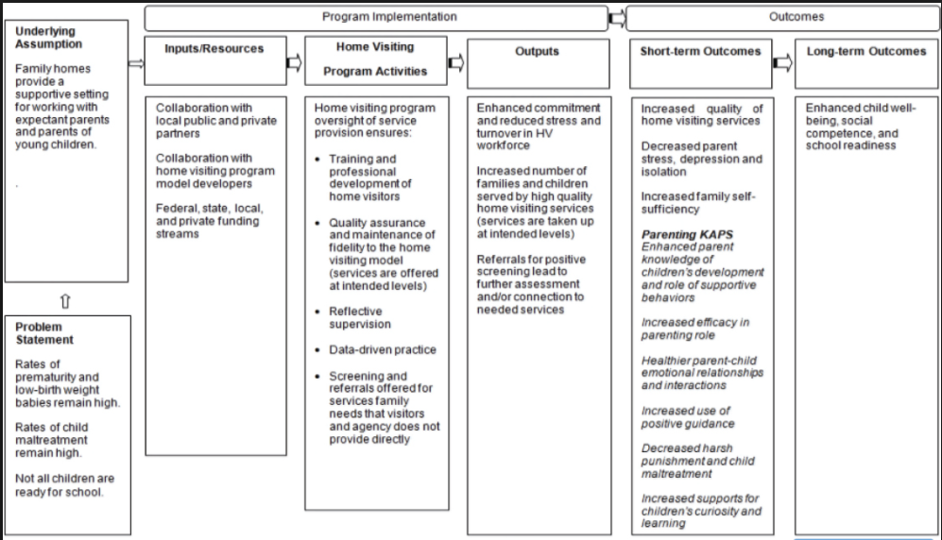
I. Logic Model Elements

Slide 17
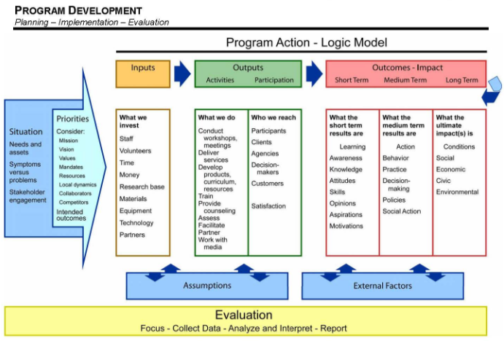
I. Logic Model Elements

Slide 18
Questions
Think of a question afterward?
Email Diane at diane@dhleonardconsulting.com
Q&A

Slide 19
Compelling Program Design Elements
Presenter: Diane H. Leonard, GPC, STSI

Slide 20
What We Will Cover:
Logic Model Elements
SMART Objectives
Work Plan Elements

Slide 21
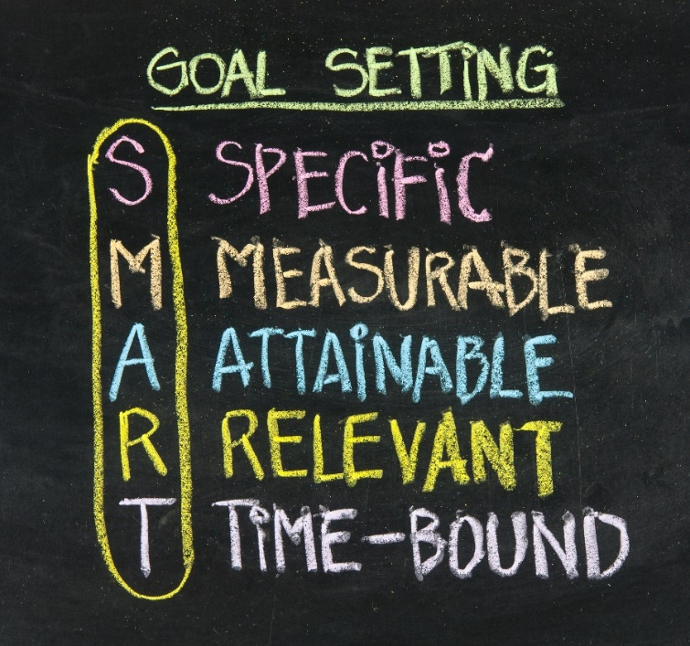
II. SMART Objectives

Slide 22
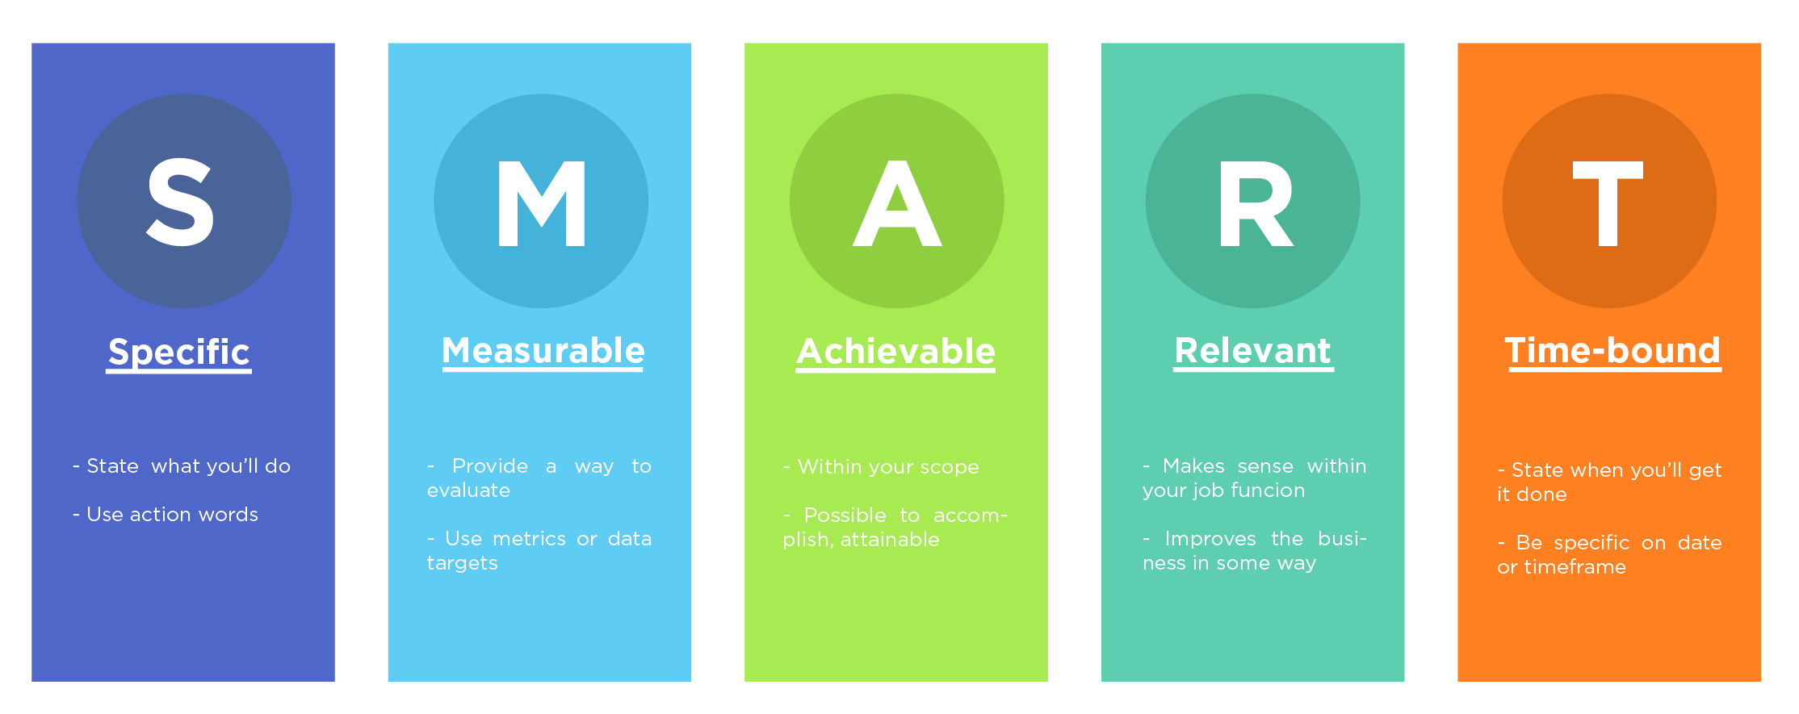
II. SMART Objectives

Slide 23
II. SMART Objectives
Goal
SMART Objective
Key Activity
Key Activity
Smart Objective
Key Activity

Slide 24
II. SMART Objectives
Goals and Objectives
A goal is an overarching principle that guides decision making.
Goals are:
Broad
General Intentions
Intangible
Abstract

Slide 25
II. SMART Objectives
Goals and Objectives
Objectives are specific, measurable steps that can be taking toward a goal
Objectives are:
Narrow
Precise
Tangible
Concrete

Slide 26
II. SMART Objectives
Old style: I will vanquish evil in a single afternoon!

Slide 27
II. SMART Objectives
SMART style: I will increase the distance from the ground by 1 meter before dinner tonight.

Slide 28
II. SMART Objectives
A non-SMART Objective:
90% of Alzheimer’s caregivers will participate in our education workshops.

Slide 29
II. SMART Objectives
What is missing?
A: Attainable
R: Relevant
T: Time-bound
….and the S and M are weak.

Slide 30
II. SMART Objectives
A SMARTer Objective:
By the end of the calendar year, Alzheimer’s Association staff will have enrolled 90% of caregivers utilizing the Adult Day Program in the Family Caregiver education series.

Slide 31
II. SMART Objectives
A non-SMART Objective:
Teachers will be trained on the selected scientifically based health education curriculum.

Slide 32
II. SMART Objectives
What is missing?
S: Specific
M: Measurable
T: Time-bound

Slide 33
II. SMART Objectives
A SMARTer Objective:
By year two of the project, LEA staff will have trained 75% of health education teachers in the school district on the selected scientifically based health education curriculum.

Slide 34
Questions
Think of a question afterward?
Email Diane at diane@dhleonardconsulting.com
Q&A

Slide 35
Compelling Program Design Elements
Presenter: Diane H. Leonard, GPC, STSI

Slide 36
What We Will Cover:
Logic Model Elements
SMART Objectives
Work Plan Elements

Slide 37
Proactive Grant Seeking
III. Work Plan Elements
Goal:
Objectives/Activities

Slide 38
Proactive Grant Seeking
III. Work Plan Elements
Key activities should include:
Planning
Design
Implementation
Execution
Evaluation
Key activities should be presented following the related SMART objective, when formatting allows.
Goal
Objective
Activity
Objective
Activity
Activity

Slide 39
Proactive Grant Seeking
III. Work Plan Elements
Key activities are not simply a listing of tasks that need to be completed when implementing a project or program.
Key activities are a compilation of specific tasks that can be measured with a combination of outputs and outcomes.

Slide 40
Proactive Grant Seeking
III. Work Plan Elements

Slide 41
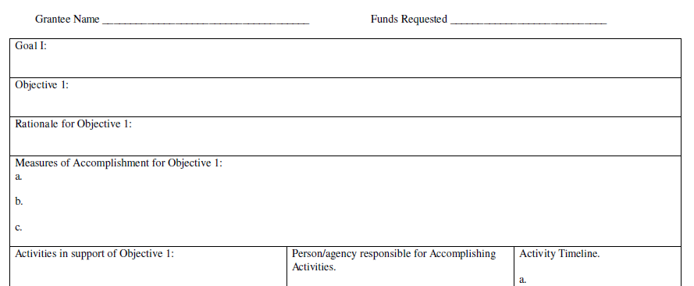
Proactive Grant Seeking
III. Work Plan Elements
You might select this template as the timeline is narrative driven: monthly, bi-weekly, quarterly, etc.

Slide 42
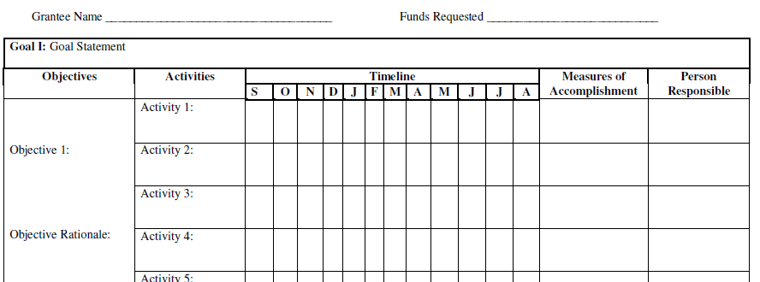
Proactive Grant Seeking
III. Work Plan Elements
You might select this template if the timeline is clearer by marking when months activities happen during.

Slide 43
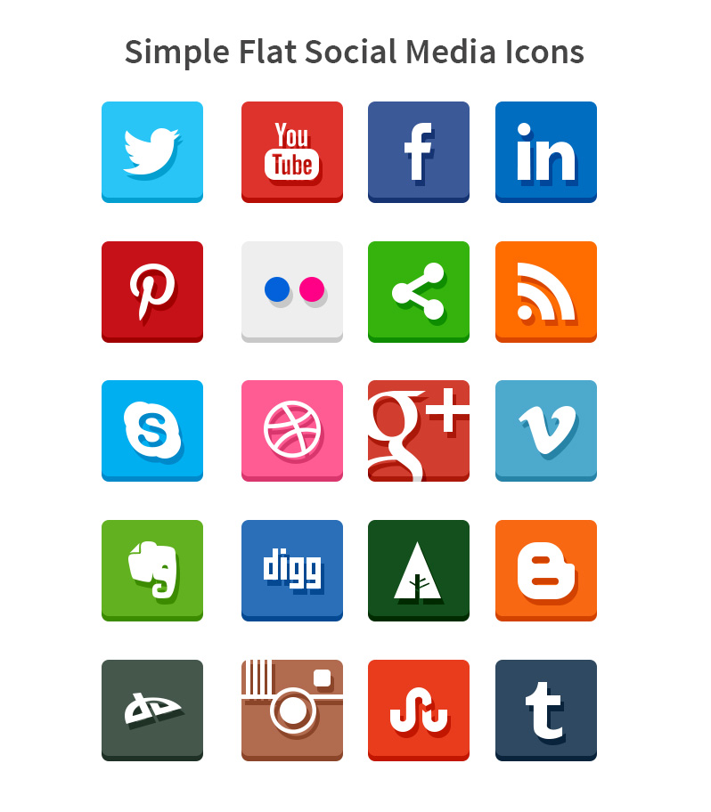
Connect With Me!
Twitter: @dhlconsult
@dianehleonard
Facebook: DH Leonard Consulting
LinkedIn: Diane H. Leonard, GPC
Instagram: @dhleonardconsulting
YouTube: Don’t Let Grants Stress You Out
www.dhleonardconsulting.com

Slide 44
Questions
Think of a question afterward?
Email Diane at diane@dhleonardconsulting.com
Q&A

Slide 45
These modules are brought to you by
HRI, the NYSDOH and HRSA
The content of this publication is solely the responsibility of the authors and does not necessarily represent the official views of HRI or HRSA
Sponsor Reference Number (6H95RH001223002)

