Slide 1
Creating Grant Application Components
Presenter: Diane H. Leonard, GPC, STSI

Slide 2
About Diane H. Leonard, GPC, STSI
Grant Professional Certified (GPC)
Approved Trainer, Grant Professionals Association
Scrum Trainer by Scrum Inc. ™ (STSI)
Certified Virtual Presenter (eSpeakers)
Began career as a grantmaker
Over $82 million awarded for clients
Owner, DH Leonard Consulting & Grant Writing Services, LLC
Runner and coffee drinker

Slide 3
What We Will Cover:
Data on Your Community and Target Audience
Organizational Structure and History
Information About Collaborative Partners
Resumes/biographical Sketches for Staff
Standard Grant Attachments

Slide 4
I. Data on Your Community and Target Audience
Source: www.learningspace.com

Slide 5
I. Data on Your Community and Target Audience
Identify and cite accurate and appropriate data sources to support proposal narratives

Slide 6
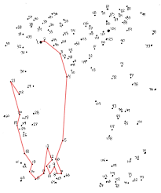
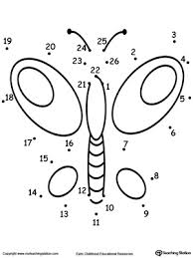
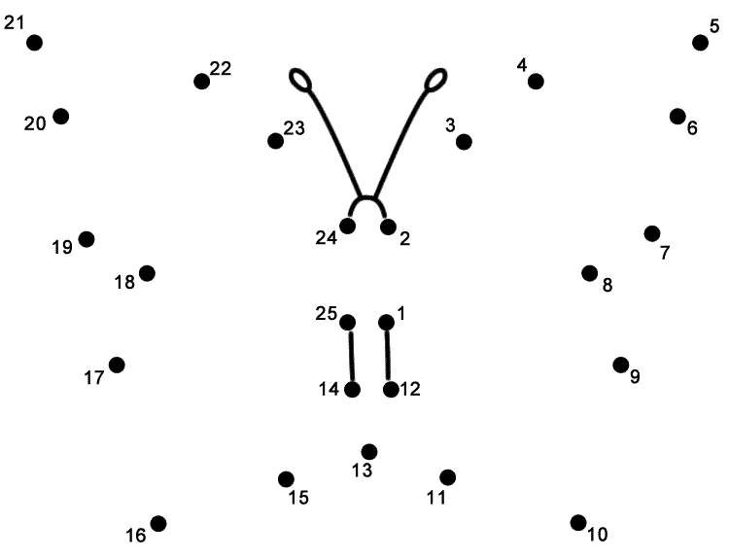
I. Data on Your Community and Target Audience
VS
VS
1
2
3

Slide 7
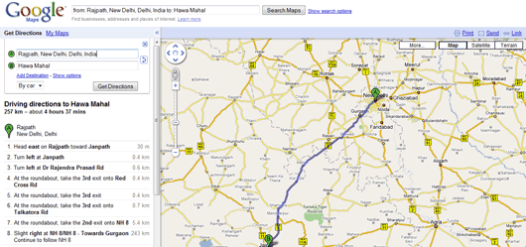
I. Data on Your Community and Target Audience
Don’t assume any reviewer knowledge or understanding of the need/problem.
Give the reviewers context and hold their hand through your explanation.
Don’t only leave them a trail of clues to piece together for a clear picture.

Slide 8
I. Data on Your Community and Target Audience
Identify Hurdles/Barriers
What are the hurdles that the target audience currently faces?
Are the barriers to service/support able to be overcome?

Slide 9
I. Data on Your Community and Target Audience
Identify Gaps
What are the current gaps in the service model for your target audience?

Slide 10
Questions
Think of a question afterward?
Email Diane at diane@dhleonardconsulting.com
Q&A

Slide 11
Creating Grant Application Components
Presenter: Diane H. Leonard, GPC, STSI

Slide 12
What We Will Cover:
Data on Your Community and Target Audience
Organizational Structure and History
Information About Collaborative Partners
Resumes/Biographical Sketches for Staff
Standard Grant Attachments

Slide 13
II. Organizational Structure and History
The organizational chart is a commonly required attachment that shows the structure and capacity of the organization.
Often a program-specific organizational chart is required instead of or in addition to the full organization.
Board
President
VP Development
VP Programs
VP Operations

Slide 14
II. Organizational Structure and History
Job Description
Position Title: ALICE Programs Director
Required Qualifications
The job titles that are in your organizational chart need to match the job titles in your staff resumes/biosketches and in your to be hired (TBH) job descriptions AS WELL AS your job titles in the budget and budget justification.
Director of Programs
Assistant Director of Programs
Senior Services Director
ALICE Programs Director (TBH)
Youth Services Director

Slide 15
II. Organizational Structure and History
Ideally, the Human Resources department should keep the organizational chart current at all time.
That way, when you are working on an application, the only request you have to make is for the new project or program portion.
Last Updated: DATE
Board
President
VP Development
VP Programs
VP Operations

Slide 16
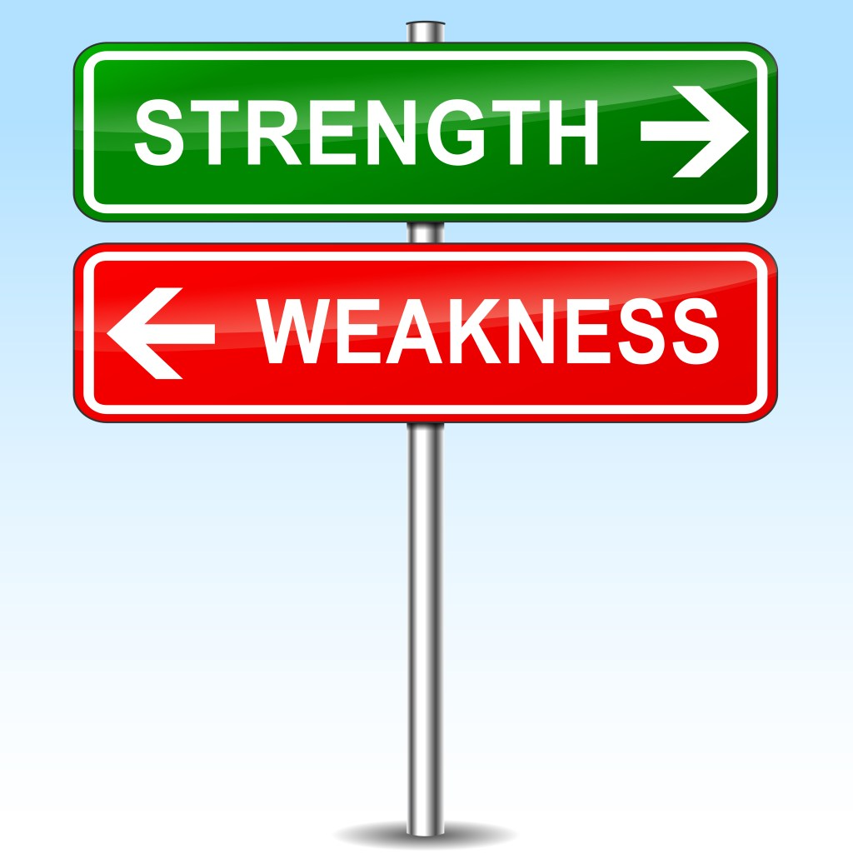
II. Organizational Structure and History
Organizational capacity in nonprofits focuses on eight key elements:
Leadership
Mission and strategy
Program delivery
Fund development
Financial management
Communications
Technology
Strategic relationships
This Photo by Unknown Author is licensed under CC BY-NC-ND

Slide 17
II. Organizational Structure and History
Strength #1: Leadership
Leadership items to highlight:
Board leadership
Staff leadership
Talent development
Succession planning
Strength #2: Mission & Strategy
Mission and strategy items to highlight:
Organizational planning
Needs assessment
Evaluation
Program development

Slide 18
II. Organizational Structure and History
Strength #3: Program Delivery
Program delivery items to highlight:
Successful pilot programs
Program design execution
Program delivery
Integration of evaluation results
Strength #4: Fund Development
Fund development items to highlight:
Fundraising strategy
Fundraising plan
Revenue-generating activities
Diversified revenues

Slide 19
II. Organizational Structure and History
Strength #5: Financial Management
Financial management items to highlight:
Day-to-day management
Financial sustainability
Long-term financial health
Risk management activities
Strength #6: Communications
Communication strengths to highlight:
Marketing
Online presence
Media relations
Awareness and outreach

Slide 20
II. Organizational Structure and History
Strength #7: Technology
Technology items to highlight:
Internal IT capacity
Privacy protocols
Tools to facilitate the work
Existing training of tools
Strength #8: Strategic Relationships
Strategic relationship items to highlight:
Legal partnerships
Collaborative partners
Engagement with stakeholders
Community support

Slide 21
Questions
Think of a question afterward?
Email Diane at diane@dhleonardconsulting.com
Q&A

Slide 22
Creating Grant Application Components
Presenter: Diane H. Leonard, GPC, STSI

Slide 23
What We Will Cover:
Data on Your Community and Target Audience
Organizational Structure and History
Information About Collaborative Partners
Resumes/biographical Sketches for Staff
Standard Grant Attachments

Slide 24
III. Information About Collaborative Partners
Program design is your idea, BUT…
As the lead applicant, the program design is YOUR idea, but many times, the program or project will not succeed without the expertise, skills, or access to the target audience that your collaborative partners bring to the table.
This Photo by Unknown Author is licensed under CC BY-NC-ND

Slide 25
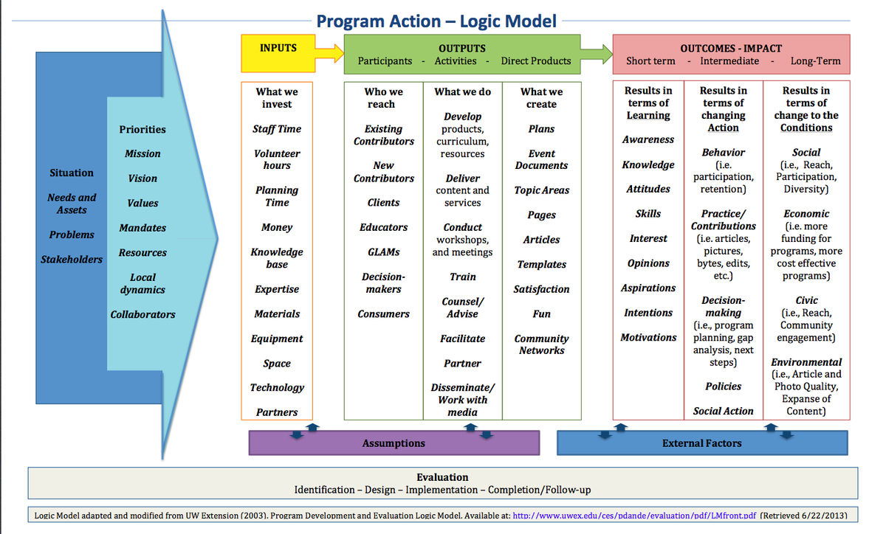
III. Information About Collaborative Partners
Logic model resources
Your collaborative partners should be a resource/input in your logic model.
Ideally, your collaborative partners also weighs in on the creation of the logic model.
This Photo by Unknown Author is licensed under CC BY-SA

Slide 26
III. Information About Collaborative Partners
Work plan collaboration
Your collaborative partners should be represented within the “Responsible People” portion of your work plan.
Ideally, your collaborative partners also weighs in on the creation of the work plan.

Slide 27
III. Information About Collaborative Partners
Evaluation needs
You will likely need to access the information and data gathered by your collaborative partners during the implementation of the program/project.
Have clear agreements in place for access to and use of data for evaluation purposes.
This Photo by Unknown Author is licensed under CC BY-SA

Slide 28
III. Information About Collaborative Partners
Budget contributions
It is critical to determine the collaborative partner’s portion of the overall grant budget early in the process.
What are they being asked to contribute to the program?
Is there enough budget to support their contributions in the work plan?
This Photo by Unknown Author is licensed under CC BY-SA

Slide 29
III. Information About Collaborative Partners
Direct costs for partners
What direct costs will they incur for the project/program?
Personnel and fringe benefits
Supplies
Equipment
Travel
Other
Indirect costs for partners
Do they already have a federally approved indirect cost rate?
Or will they be claiming the 10% de minimis rate?
Be SURE to talk with collaborative partners about your responsibilities as a lead applicant related to indirect costs.

Slide 30
Questions
Think of a question afterward?
Email Diane at diane@dhleonardconsulting.com
Q&A

Slide 31
Creating Grant Application Components
Presenter: Diane H. Leonard, GPC, STSI

Slide 32
What We Will Cover:
Data on Your Community and Target Audience
Organizational Structure and History
Information About Collaborative Partners
Resumes/biographical Sketches for Staff
Standard Grant Attachments

Slide 33
IV. Resumes/biographical Sketches for Staff
Each grantmaker (especially with government grants) has different guidelines for the formatting requirements, length, and content of resumes/curriculum vitae (CV) and job descriptions.
Read each set of guidelines to ensure your attachments meet their requirements!
Biosketch
Name:
Position Title:
Required Qualifications:
Guidelines for Biosketch Formatting

Slide 34
IV. Resumes/biographical Sketches for Staff
Current staff
Guidelines may refer to the documents for current employees as:
Resumes
Biographical sketches
Curriculum Vitae (CV)
Future staff
Guidelines may refer to the documents for future employees as:
Job descriptions
Position descriptions

Slide 35
IV. Resumes/biographical Sketches for Staff
If a current employee is part of the logic model, work plan, staffing plan, and budget, you should include their resume unless the guidelines ask for only key personnel.
In that case, double check their definition of key personnel and include only those resumes.
This Photo by Unknown Author is licensed under CC BY-SA

Slide 36
IV. Resumes/biographical Sketches for Staff
If a proposed position will be created/hired when funding is awarded, you OFTEN need to provide the job description NOW even though you are not opening the hiring process.
Read the guidelines carefully – do they want job descriptions for all new personnel, or only new key personnel?
This Photo by Unknown Author is licensed under CC BY

Slide 37
Questions
Think of a question afterward?
Email Diane at diane@dhleonardconsulting.com
Q&A

Slide 38
Creating Grant Application Components
Presenter: Diane H. Leonard, GPC, STSI

Slide 39
What We Will Cover:
Data on Your Community and Target Audience
Organizational Structure and History
Information About Collaborative Partners
Resumes/biographical Sketches for Staff
Standard Grant Attachments

Slide 40
V. Standard Grant Attachments
Preparing your standard grant applications in advance to use throughout a fiscal year takes the pressure off during grant application process.
This Photo by Unknown Author is licensed under CC BY-SA-NC

Slide 41
V. Standard Grant Attachments
Key Items to Gather/Prepare in Advance:
501(c)3
Previous Year’s Financials
Previous Year’s Audit (if appropriate)
Board Roster
Board Approved Operating Budget
Project/Program Budgets (Fiscal Year)
Resumes/Biosketches
Annual Report

Slide 42
V. Standard Grant Attachments
Provide only the attachments requested.
If there are other attachments you wish to provide that are not requested with the application, reference them in your cover letter as available upon request from the funder.

Slide 43
V. Standard Grant Attachments
But what if they offer you the chance for an “optional” or “additional” attachment?
You should only provide ONE additional attachment.
Decide which ONE item will add to your application’s overall story. NOT two or more items combined into one file, JUST one file.
This Photo by Unknown Author is licensed under CC BY-SA

Slide 44
Connect With Me!
Twitter: @dhlconsult
@dianehleonard
Facebook: DH Leonard Consulting
LinkedIn: Diane H. Leonard, GPC
Instagram: @dhleonardconsulting
YouTube: Don’t Let Grants Stress You Out
www.dhleonardconsulting.com

Slide 45
Questions
Think of a question afterward?
Email Diane at diane@dhleonardconsulting.com
Q&A

Slide 46
These modules are brought to you by
HRI, the NYSDOH and HRSA
The content of this publication is solely the responsibility of the authors and does not necessarily represent the official views of HRI or HRSA
Sponsor Reference Number (6H95RH001223002)

